Slide 1
Considering an Academic Public Health Career
Opportunities with the NIHR

Slide 2



Slide 3



Research Capacity Development
The NIHR Academy is responsible for the development and coordination of NIHR academic training, career development and research capacity development
Key recommendation of the NIHR Strategic Review of Training was for the development of NIHR Incubators; as an approach to support capacity building and multidisciplinary career development in areas of strategic need.
Currently, 10 active Incubators; including the NIHR Incubator in Public Health (insert link to PH incubator once content has been uploaded)

Slide 4
Public Health Incubator
“aims to stimulate and inspire those working in
the public health academic/practice field to pursue academic research careers”
“enhance the opportunities for those pursuing academic careers through better sign-posting to funding opportunities and career support activities”

Slide 5
Considering an academic public health career?
Are you considering a career in academic public health?
There are opportunities at the NIHR that:
  Allow you to pursue a purely academic path, or a path that combines your academic and practice roles
  Cater to different professional backgrounds
  Are available at different career stages
This presentation will help you to navigate to the most appropriate career pathway and funding opportunities for you

Slide 6
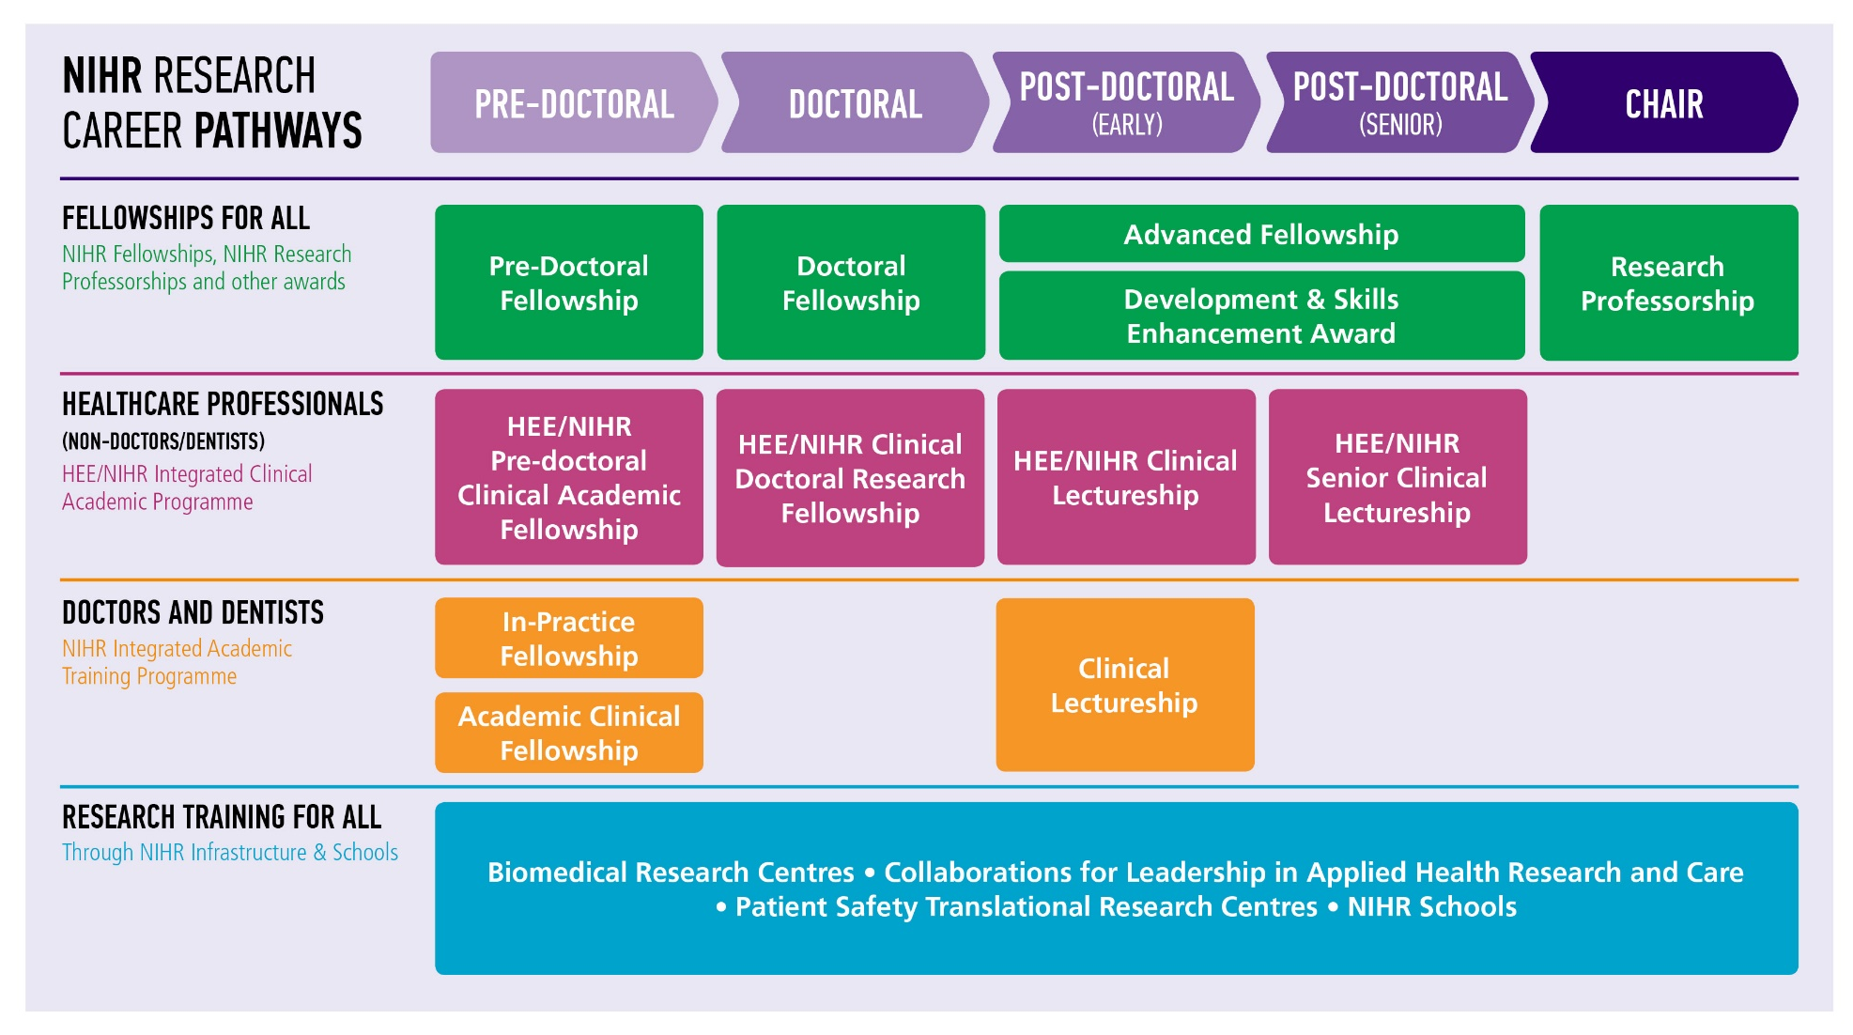
Biomedical Research Centres Applied Research Collaborations
Patient Safety Translational Research Centres NIHR Schools
Health Protection Research Units
Notes:
Charlie to take over

Slide 7
First steps
Your experiences and background to date combined with your aspirations for the future will determine which opportunities you aim for:
There are specific pathways for those who:
Are trained as Doctors/Dentists and typically work in the NHS
Are from Public Health Speciality Training – and typically work in a non-NHS practice setting
Are Non-doctor/dentist and non-Public Health Speciality Training – and typically work in an Higher Education Institute (HEI)
Initial questions to consider are whether you want to:
combine your practice and academic roles or
undertake a purely academic opportunity

Slide 8


For those who are trained as Doctors/Dentists and typically work in the NHS
The Academic Clinical Fellowship and Clinical Lectureships are aimed at individuals wishing to develop a career in research alongside clinical training
ACFs: Launch in October annually
CLs: Launch in March annually

Slide 9
Integrated Academic Training
Academic Clinical Fellowships (ACFs) & Clinical Lectureships (CLs)
Institutional awards, awarded to medical school partnerships.
ACFs are pre-doctoral and early ST training. Recruitment is led by HEE.
CLs for post-doctoral and ST3+ training. Candidates apply to medical schools
CL opportunities may be advertised on jobs.ac.uk, or HEI websites.
In-Practice Fellowship (IPF)
The IPF is a pre-doctoral, personal training award for GPs/GDPs to support a PhD application.
IPF candidates apply directly to NIHR

Slide 10
Useful Resources
IAT Programme (ACFs & CLs)
www.nihr.ac.uk/IAT
IAT Guide (the NIHR companion to the Gold Guide)
www.nihr.ac.uk/IATguide
IAT Training Leads
www.nihr.ac.uk/IATleads
James Lind Alliance Priority Setting Partnerships
http://www.jla.nihr.ac.uk/
AMS Starter Grants for CLs
https://acmedsci.ac.uk/grants-and-schemes/grant-schemes/starter-grants

Slide 11


Are from Public Health Speciality Training – and typically work in a non-NHS practice setting
The Health Education England (HEE) and NIHR Integrated Clinical Academic (ICA) Programme provides personal research training awards for health and social care professionals (excluding doctors and dentists) who wish to develop careers that combine practice research and research leadership with continued practice and practitioner development.

Slide 12
Are Non-doctor/dentist and non-Public Health Speciality Training – and typically work in an Higher Education Institute (HEI)
NIHR Fellowships support individuals with the potential and on a trajectory to become future leaders in NIHR research. The Fellowships have been designed to support people at various points of their development to become leading researchers, from initial pre-doctoral training to senior post-doctoral research
Doctoral and Advanced Fellowships can be taken part time

Slide 13
Pre-doctoral Fellowship
Fellowship designed to support people early on in their career, who are looking to develop a career in research methods:
  Completion of a broad masters level (or full masters) training programme, to be in a strong position to go into a range of further health research related roles, e.g. applied statistician in a CTU.
  Completion of a masters level training programme specifically designed to support the applicant to undertake a future PhD.
Covers; medical statistics, health economics, clinical trial design, operational research, modelling, bioinformatics, qualitative research, mixed methods.
Funding and support
1-2 years WTE (between 50 and 100% WTE)
Funding for salary, training and development up to £5,000 and supervision up to £1,000
Masters fees (UK standard cost)
NIHR website includes a list of supervisors to help applicants find potential suitable hosts
Launches annually in January

Slide 14
Doctoral Fellowship
Fellowship to undertake a PhD
Open to clinical and non-clinical applicants
Funding and support
3 years WTE (between 50 and 100% WTE)
Funding for salary, PhD fees, research costs and training and development
20% of time can be clinical/practice
Assessment criteria
Suitability and commitment to develop a career as a researcher in applied health or social care research. Potential to become a future leader.
High quality research and training programme suitable for a PhD
Support from supervisory team and host organisation
Launches twice a year: April and October
Strategic Themes
Key Priority Areas: Social Care, Public Health, Mental Health and Health Data Science

Slide 15
Advanced Fellowship
Fellowship designed to support the following points at post-doctoral level:
Early post-doc career following award of PhD
Establishment of independence
Transition or return from a career break
Open to clinical and non-clinical applicants
Funding and support
2-5 years WTE (between 50 and 100% WTE)
Funding for salary, research costs and training and development
Up to 40% clinical service/development/practice time
Can apply for 2 sequential Fellowships up to a total of 8 years
Assessment criteria
Trajectory relevant to career stage and background
High quality research and training programme
Support from mentorship team and host organisation
Launches twice a year: April and October
Strategic Themes
Key Priority Areas: Social Care, Public Health, Mental Health and Health Data Science

Slide 16
Advanced Fellowship in Knowledge Mobilisation Research
Post-doctoral award that has been designed for individuals who have significant health/social care and/or academic experience and can demonstrate that they:-
(a) have the potential to mobilise research knowledge in health and social care settings and
(b) can contribute to the research base underpinning knowledge mobilisation activities
Funding and support
available for a maximum of 24 months full time (part time options between 50% and 100% available).
Funding for salary, research costs and training and development

Slide 17
Development and Skills Enhancement (DSE) Award
For NIHR Academy Members to gain specific skills and experience
“Bridging with a purpose”
Includes support for career continuity for those who haven’t been able to source support elsewhere
Funding and support
1 year maximum (between 50 and 100% WTE)
Funding for salary, training and development, and supervision
Expectation of matched funding from host – Assessed as part of application
Assessment criteria
Continued commitment to a academic research career
Clear plan for supporting future NIHR funding application
Support from host organisation
Launches three times a year in May, September and January

Slide 18
Seeking Support
For detailed advice on which opportunity best supports your background and future career aspirations contact the NIHR Academy office:
https://www.nihr.ac.uk/explore-nihr/support/academy.htm
For advice on the research you want to undertake, contact your local Research Design Service (RDS):
https://www.nihr.ac.uk/explore-nihr/support/research-design-service.htm

Slide 19

NIHR Blogs
Professor Gary Frost (Chair of the Doctoral Fellowship Selection Committee) "What makes an application excellent?"
Professor Jane Parry (Chair of the Advanced Fellowship Selection Committee) "The common characteristics of a great Fellowship application"

Slide 20
Case Studies
Variety of case studies to be inserted here; highlighting a range of NIHR Academy members undertaking public health research at differing career stages, professional backgrounds and spanning academic/practice

Slide 21

NIHR Mentorship Programme
NIHR Academy’s Mentorship Programme is open to all post-doctoral NIHR Academy members; irrespective of professional background from 2021.
Access to mentors; providing independent advice and support regarding career development and overcoming potential barriers to career progression.

Slide 22

Future-Focussed Leadership Programme
The new Future-Focussed Leadership Programme enables you to develop your capabilities and effectiveness as a leader by identifying and reflecting on your strengths and areas for development.

Slide 23

Emerging Research Leaders Stream
The Emerging Research Leaders stream is for early to mid-career researchers on an academic track, who are taking up their first significant leadership and management roles
To be eligible for the Emerging Research Leaders stream you must be:
an early to mid-career researcher
two years post doctorate
an NIHR Academy Member.

Slide 24
NIHR School for Public Health Research (SPHR)

Slide 25

Established in April 2012, the SPHR is a partnership between eight leading academic centres with excellence in applied public health research in England.
The School is committed to equipping its trainees with the tools to develop and build a research career in public health, by providing options to combine academic research with practice and a range of training and development opportunities

Slide 26
Range of training opportunities including:-
Summer Internships (funded 6-8 week internship aimed at undergraduate students with an interest in a career in public health research)
Pre-doctoral Fellowships (up to 24 months for individuals to gain experience, knowledge and, skills and to prepare an application to undertake a PhD in public health research)
PhD studentships (allows students to benefit from cross-member and practice involvement in their supervision and opportunities for short, practice-based placements)
Post-doctoral launching Fellowships (up to 24 months and provides an opportunity for the Fellow to publish papers from their PhD and write a fellowship or grant application(s) to secure further funding)

Slide 27


Further Information
SPHR Training Animation showcasing their PhD students and Fellows, as well as highlighting the various training and development opportunities available.
Dedicated area for Public Health Professionals; outlining opportunities available for public practitioners; including practitioner focussed research briefings

Slide 28
Further PH Career Development Opportunities
Insert MRC, Wellcome, Health Foundation, UKRI opportunities etc

